Slide 1
Final Project Massage Booking System ITE 441 Database Management System
Member Group
Tinnapob Jiamjriyawat 1901070011
Kridsadee Imarom 1901240002
Fardina Kabir 1910080005

Slide 2
Introduction
We found some massage shop almost no IT involved at all the booking system for massage time uses all people, that is, customers call to reserve by phone only or come in without a reservation and have to wait in line. If the queue is busy at present, there are 3 employees and 1 shop owner and quite a lot of customers. Causing not answering the phone in time because there is no IT system. Therefore we created the database to use with application

Slide 3
We created this system by following the topic:
Mini world
Requirement
ER-Diagram
UML-Diagram
A state for massage shop database
Forward engineer
Discussion & Conclusion

Slide 4
Mini world
Customer | Customer_ID Customer_firstName Customer_LastName Customer_PhoneNumber
Order | Customer_ID Order_Date CreditCard TotalAmount OrderStatus
Order Detail | Order_No Massage_Time Price Total
Product | Massage_Type Massage_NO Massage_Time

Slide 5
Requirement
To reduce data redundancy
Can be run by multiple users
No interruptions or delays
To work as a system based on the application
Get more customers than ever before.
Reduce staff work
To make the shop look modern
To facilitate booking

Slide 6
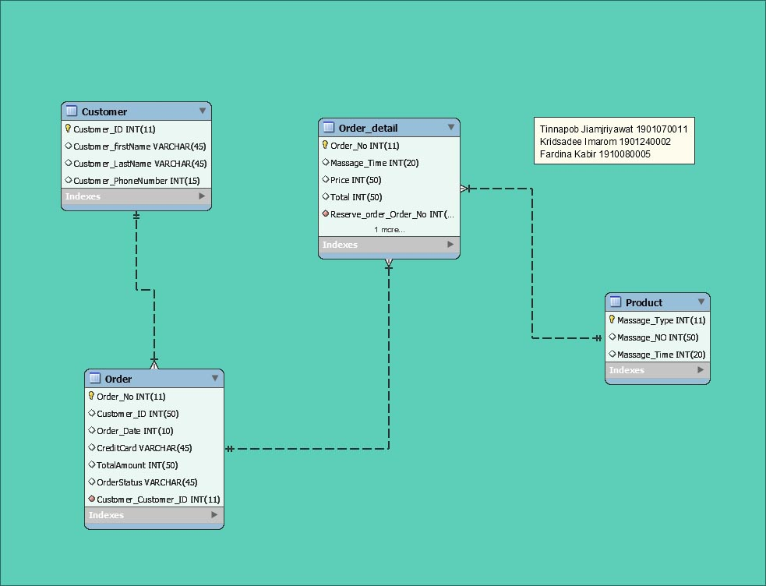
ER-Diagram

Slide 7
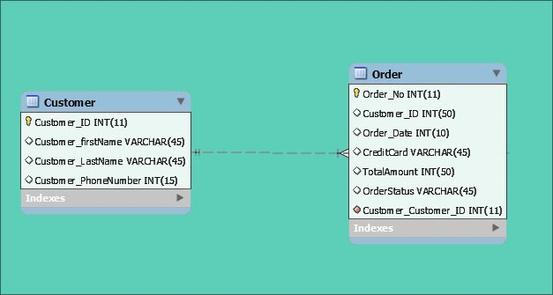

Slide 8
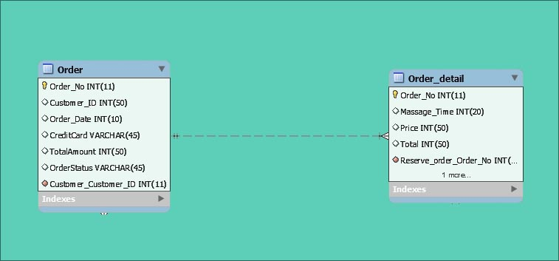

Slide 9
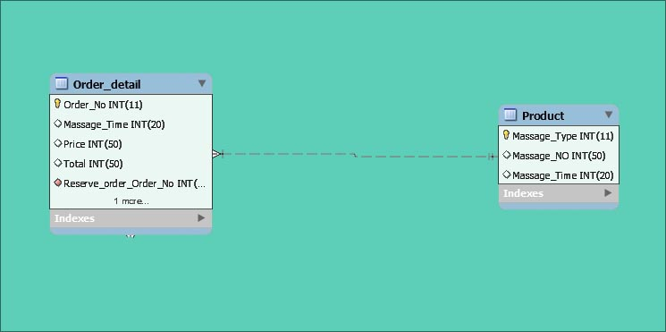

Slide 10
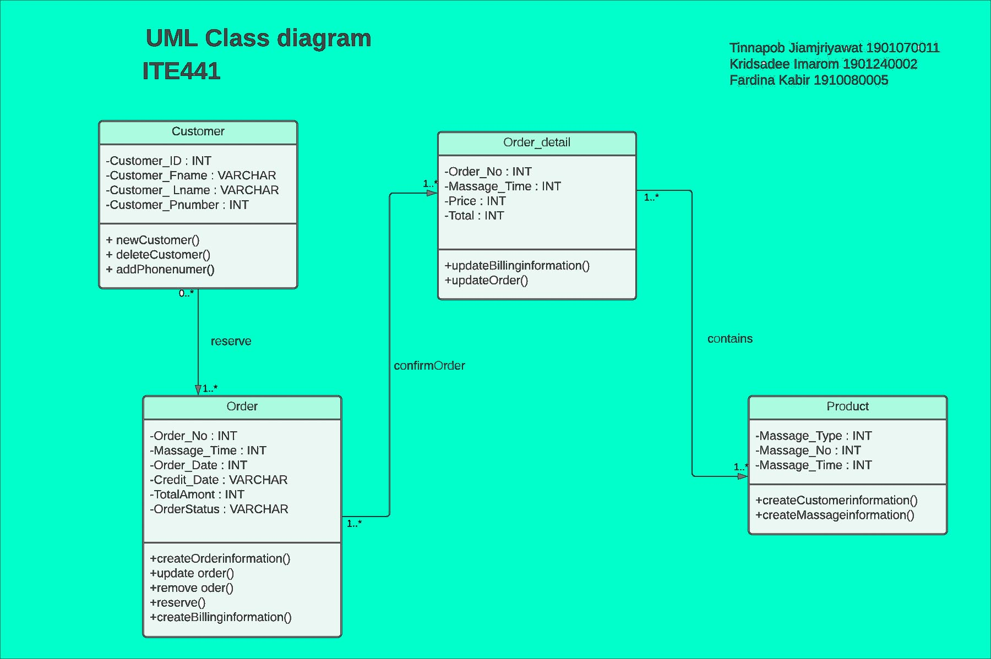
UML- Diagram

Slide 11
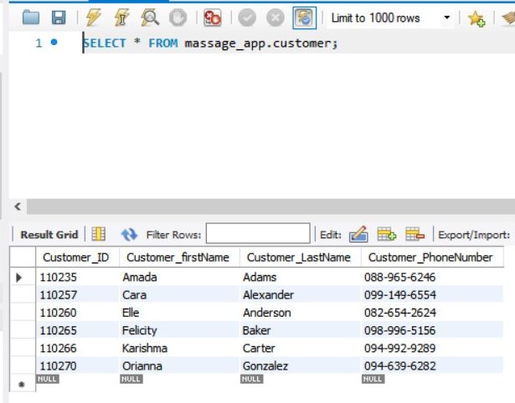
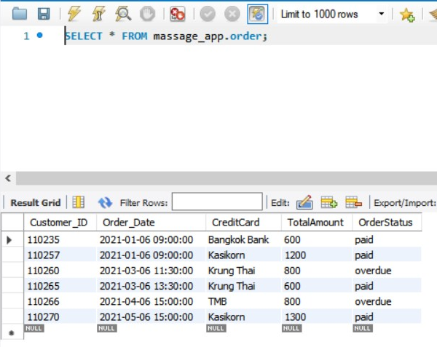
A state for massage shop database

Slide 12
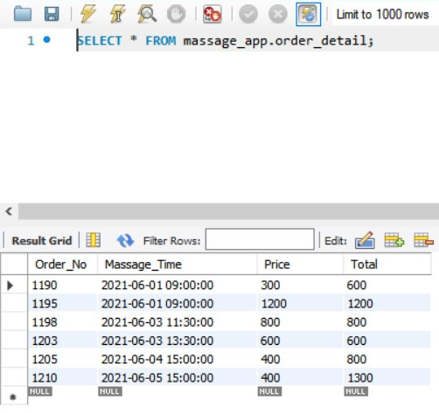
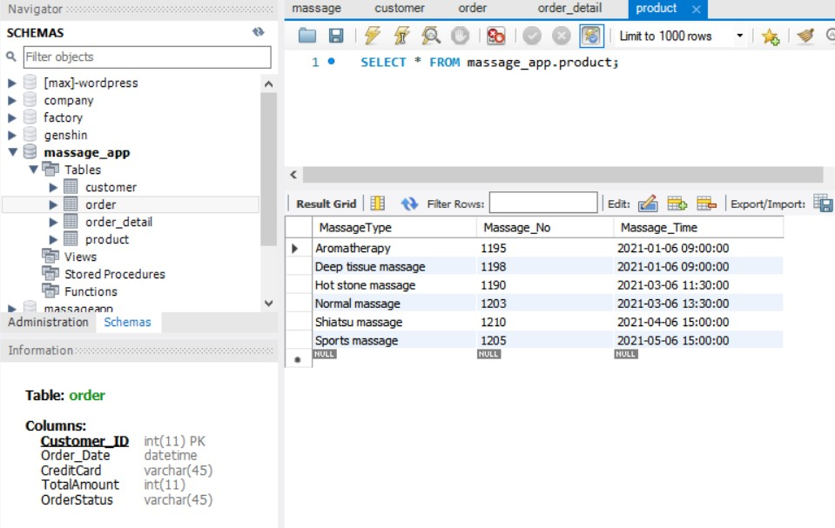
Tables

Slide 13
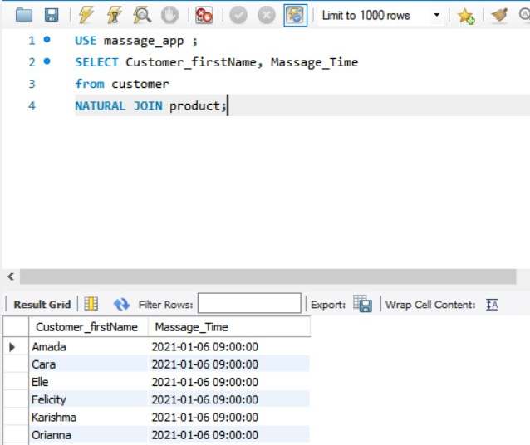
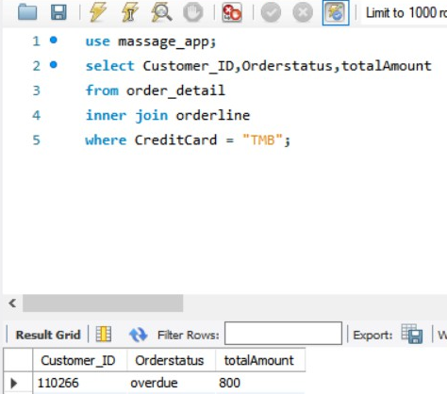
Tables

Slide 14
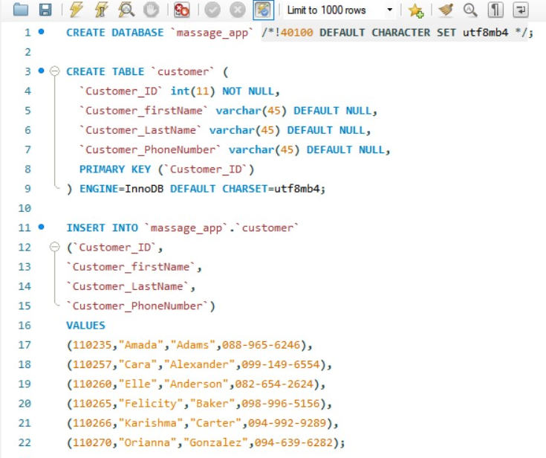
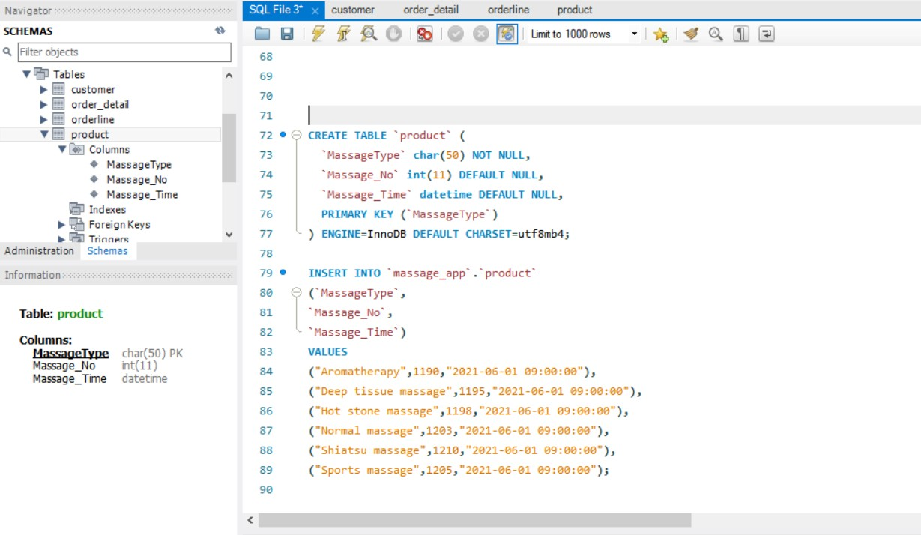
Forward engineer

Slide 15
Discussion & Conclusion
According to the reservation system of massage parlors, the main problem is the delay in booking and there are errors
Therefore, after creating a new system, customers will be able to choose the date, time, type of massage and can choose a massage therapist. By using the online system
Massage therapists will be able to work quickly. More accurate and efficient because the system is able to notify the selected employee
In addition, customers can also receive a notification of the date and time of the reservation 1 hour before

Slide 16
This is what we would like to improve
Add a function to collect points per 1 booking so that customers can exchange points for a massage time.
Make a rank, starting from Silver – Diamond, the rank will increase as more customers use the booking service in the app. to make the app look playful

